Slide 1
Women of mathematics from around the world
A gallery of portraits
Summer School "Modern Problems in PDEs and Applications“
Ghent, 28th August 2023

Slide 2
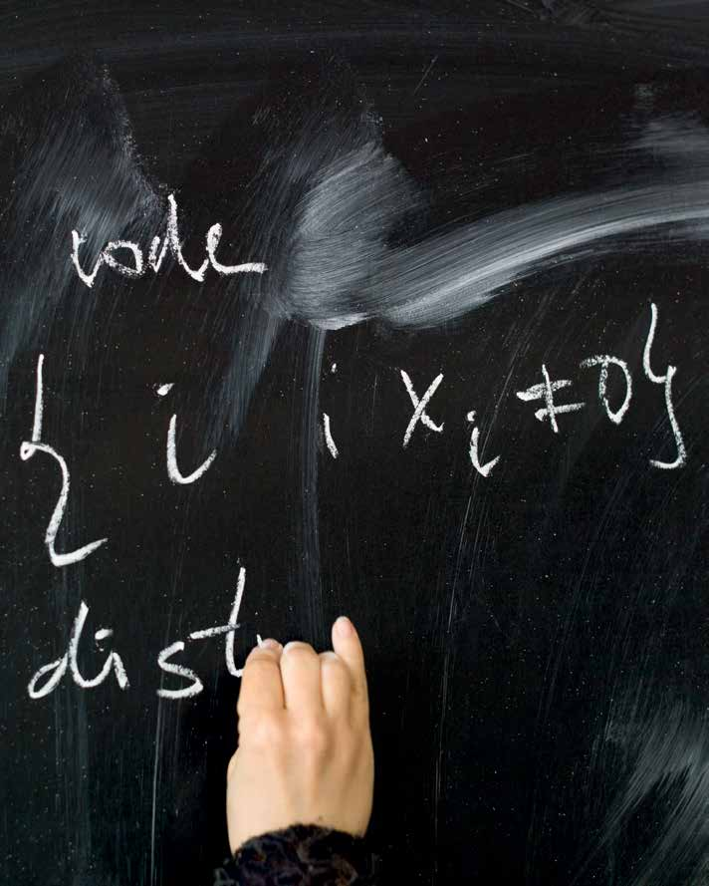
Women of mathematics throughout Europe
A gallery of twenty three portraits
The short story of a long adventure
Noel Tovia Matoff photographer
Sylvie Paycha curator

Slide 3
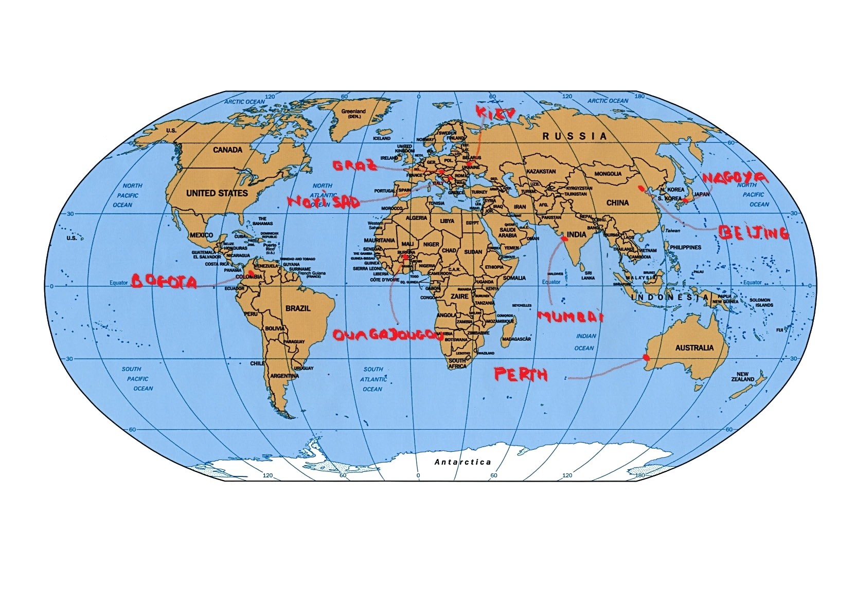
How it all started: 2013
invitation by Charu Goel to deliver a talk in the
“Women in mathematics” platform at the University of Konstanz
Alexandra Antoniouk (Ukraine)
Karin Baur (Switzerland/ Austria)
Luz Myriam Echeverry (Colombia)
Yukari Ito (Japan)
Marie Françoise Ouedraogo
(Burkina Faso)
Dusanka Perisic (Serbia)
Cheryl Elisabeth Praeger (Australia)
Minping Qian (China)
Ramdorai Sujatha (India)
Jie Yang (China)
WOMEN MATHEMATICIANS
AROUND THE WORLD
A GALLERY OF TEN PORTRAITS

Slide 4
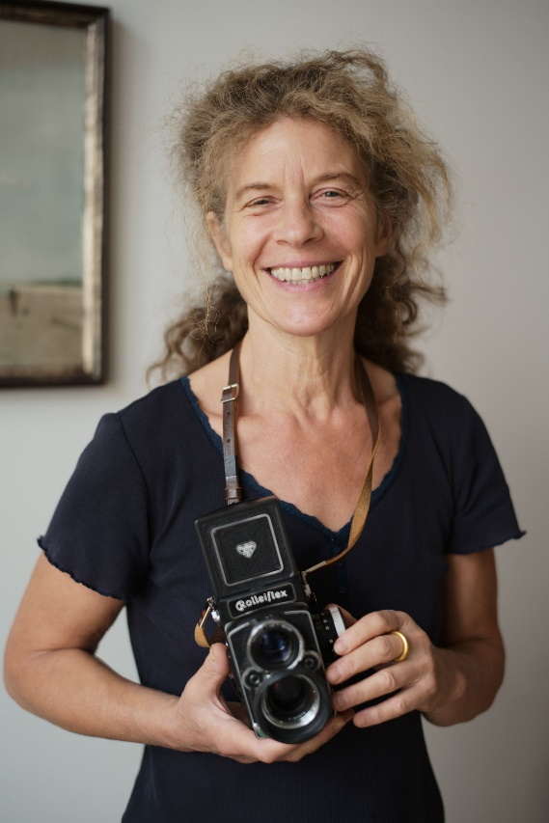
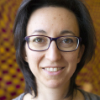
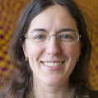
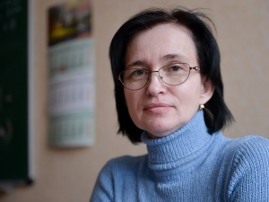
2014 First steps
Agnes Handwerk suggests an exhibition with portraits of mathematicians based in Europe
Noel Matoff
The photographer
13 female mathematicians
Nalini Anantharaman (France)
Karin Baur (Switzerland, Austria)
Stefka Bouyuklieva (Bulgaria)
Alice Fialowski (Hungary)
Frances Kirwan (UK)
Irina Kmit (Ukraine/Germany)
Kaisa Matomäki (Finland)
Margarida Mendes Lopes (Portugal)
Barbara Nelli (Italy)
Dušanka Perišić (Serbia)
Katarzyna (Kasia) Rejzner (Poland/UK)
Katrin Wendland (Germany)
Oksana Yakimova (Russia/Germany)
The team of mathematicians
Magdalena
Georgescu
Alexandra Antoniouk
Sara Azzali

Slide 5
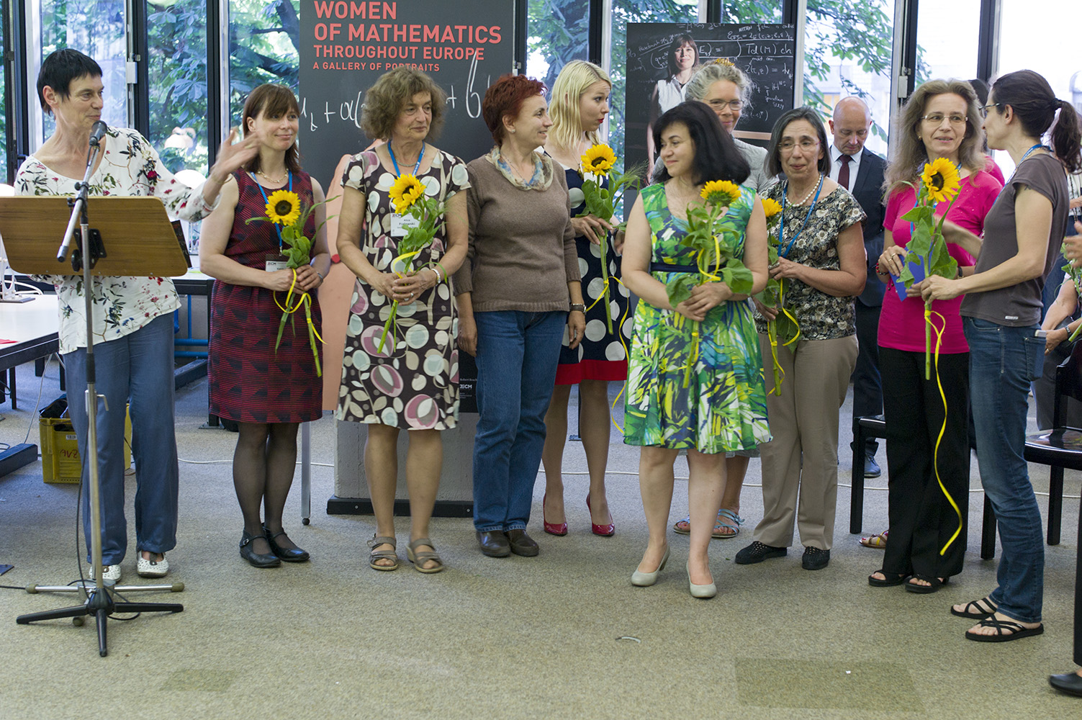
, Mathematics Library
Technical University in Berlin
July 2016: Opening in Berlin (TU)
7th European Congress of Mathematics
Stefka Bouyuklieva
Kasia Keijzner
Dušanka Perišić
Katrin Wendland
Alice Fialowski
Margarida Mendes Lopes
Stefka Bouyuklieva
Irina Kmit
Sylvie Paycha
Karin Baur

Slide 6






With the financial support of

Slide 7
2016------2021
THE THIRTEEN PORTRAYED MATHEMATICIANS
Nalini Anantharaman (France)
Karin Baur (Switzerland, Austria)
Stefka Bouyuklieva (Bulgaria)
Alice Fialowski (Hungary)
Frances Kirwan (UK)
Irina Kmit (Ukraine/Germany)
Kaisa Matomäki (Finland)
Margarida Mendes Lopes (Portugal)
Barbara Nelli (Italy)
Dušanka Perišić (Serbia)
Katarzyna (Kasia) Rejzner (Poland/UK)
Katrin Wendland (Germany)
Oksana Yakimova (Russia/Germany)

Slide 8
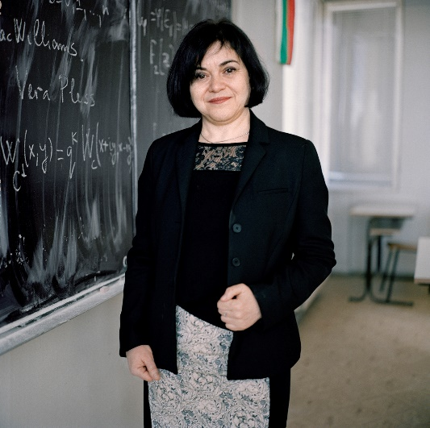
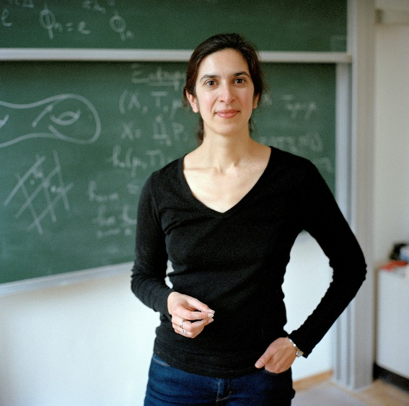
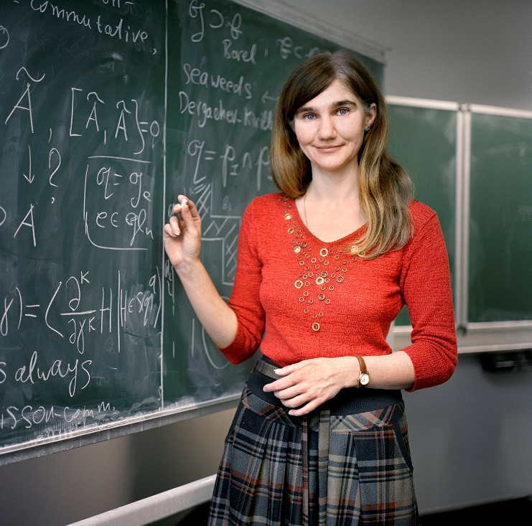
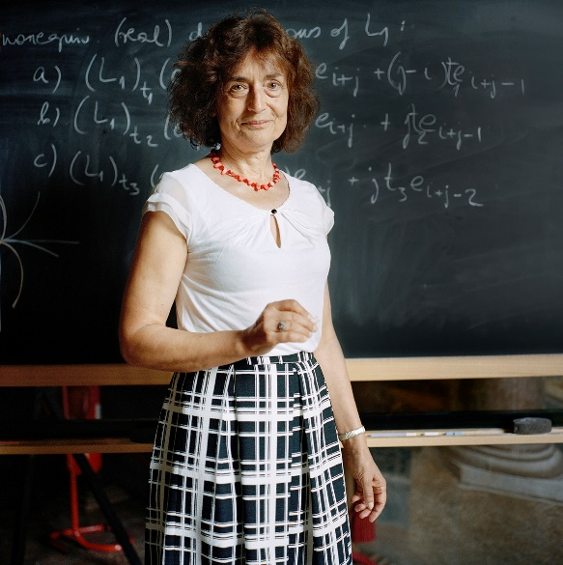
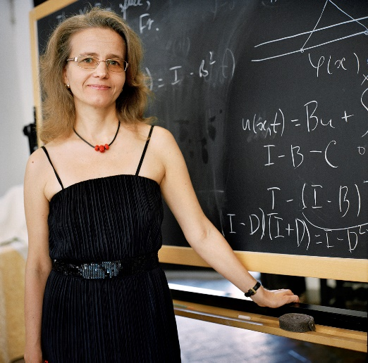
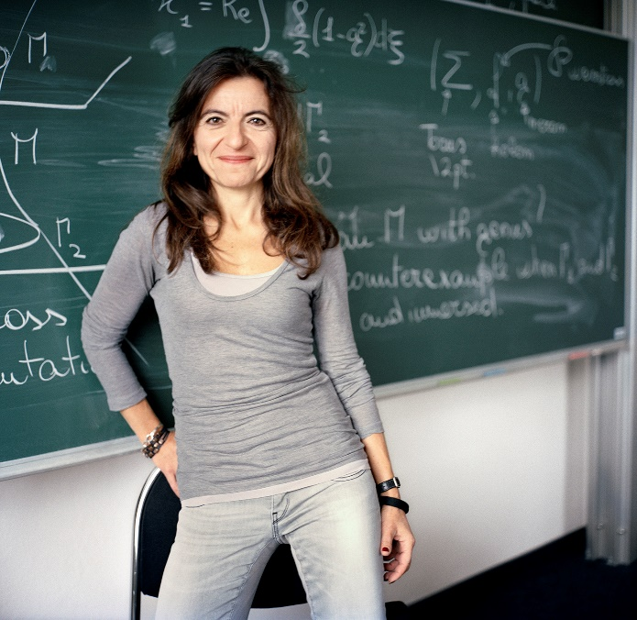
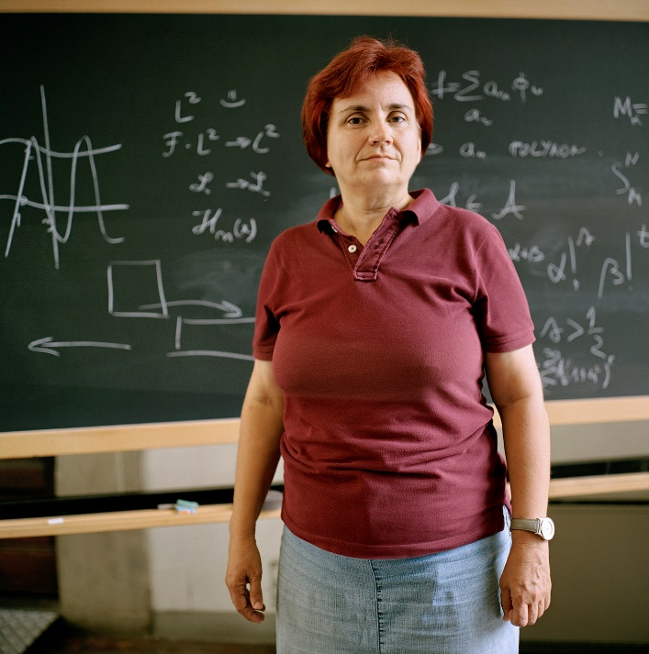
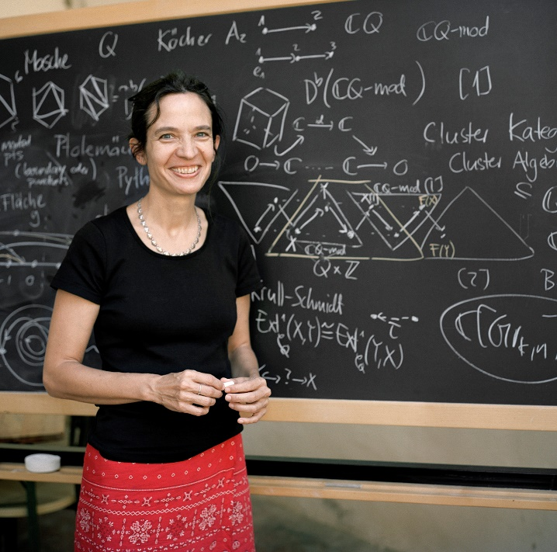
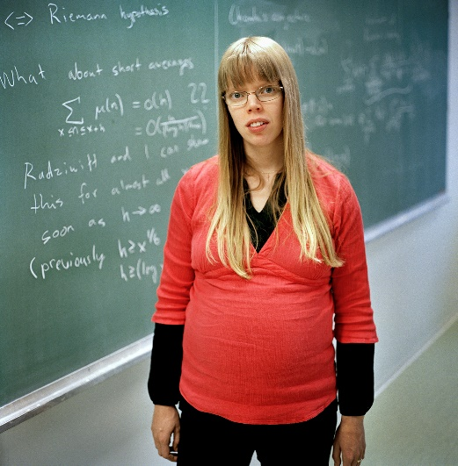
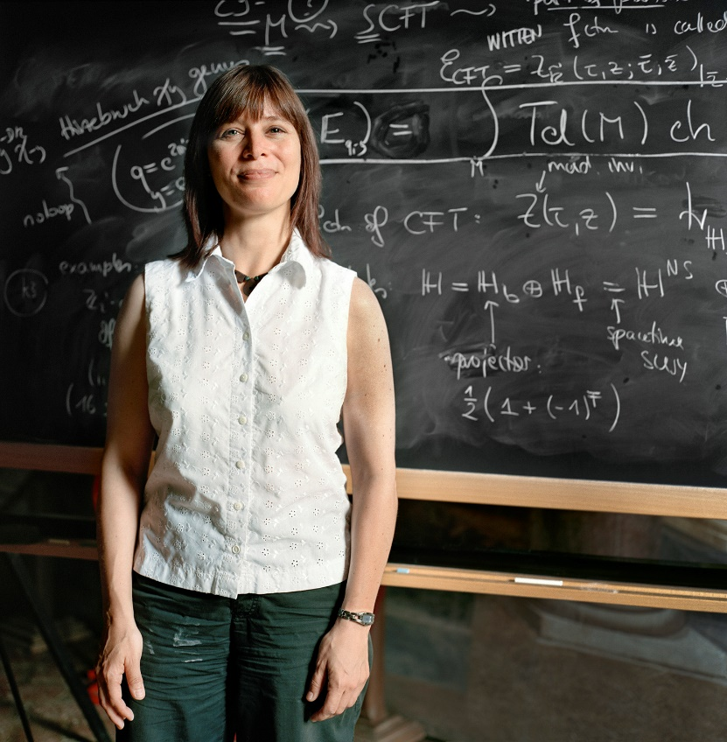
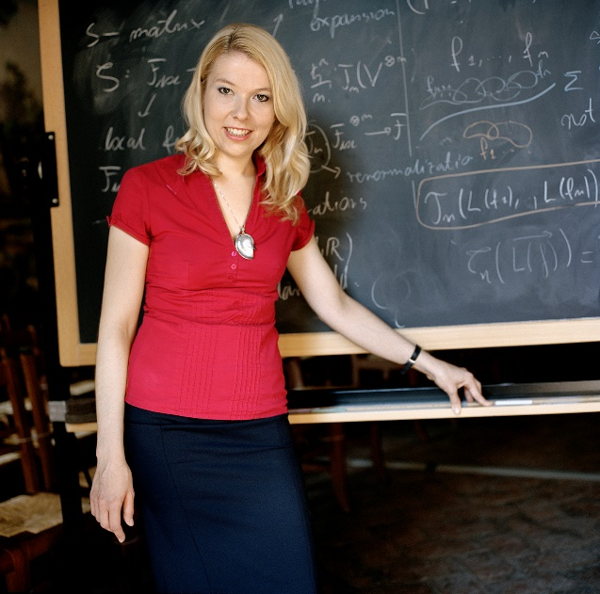
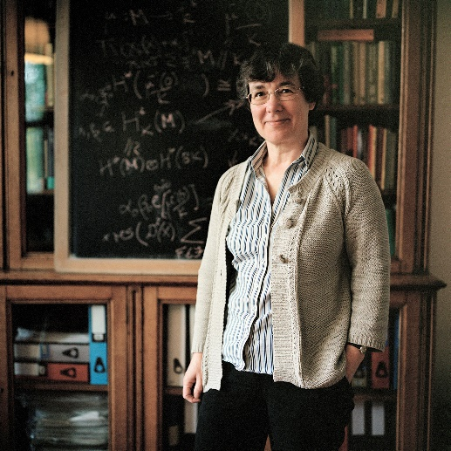
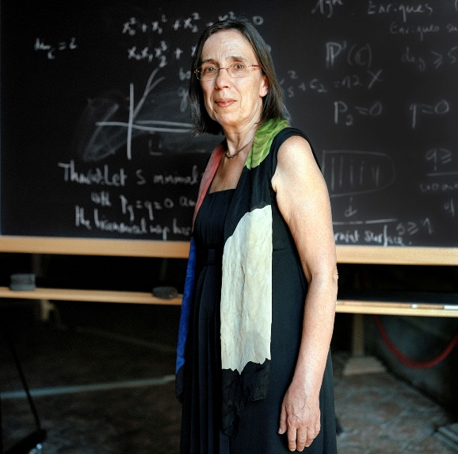
Alice Fialowski
Stefka Bouyuklieva
Nalini Anantharaman
Irina Kmit
Barbara Nelli
Oksana Yakimova
Kaisa Matomäki
Karin Baur
Katrin Wendland
Dušanka Perišić
Frances Kirwan
Kasia Rejzner
Margarida Mendes Lopes

Slide 9
TRAVELLED TO MORE THAN
150 VENUES
AROUND THE WORLD……

Slide 10
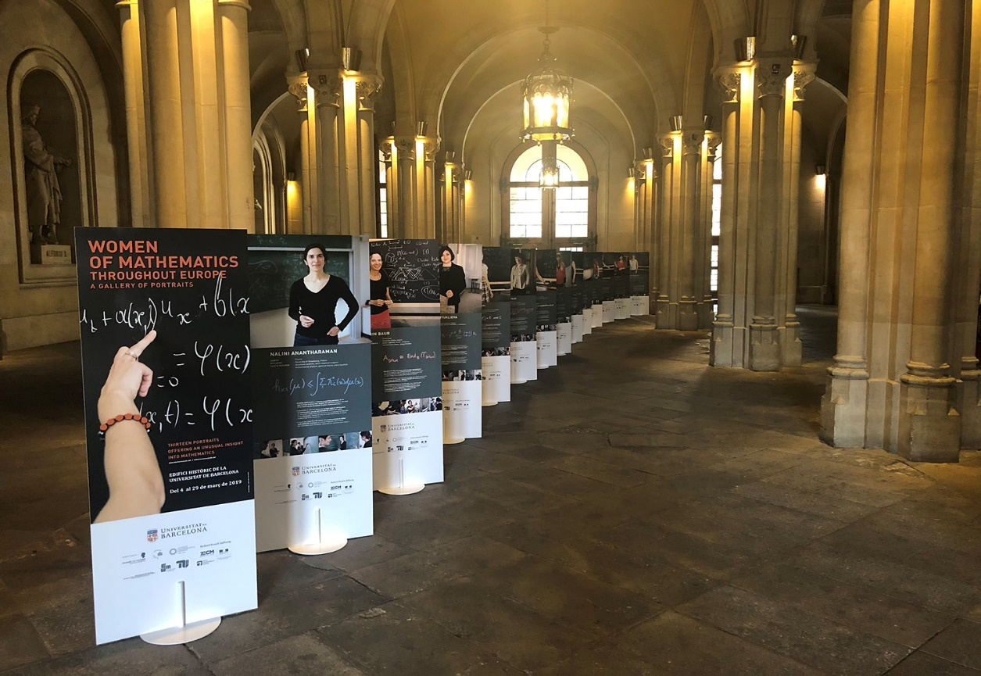
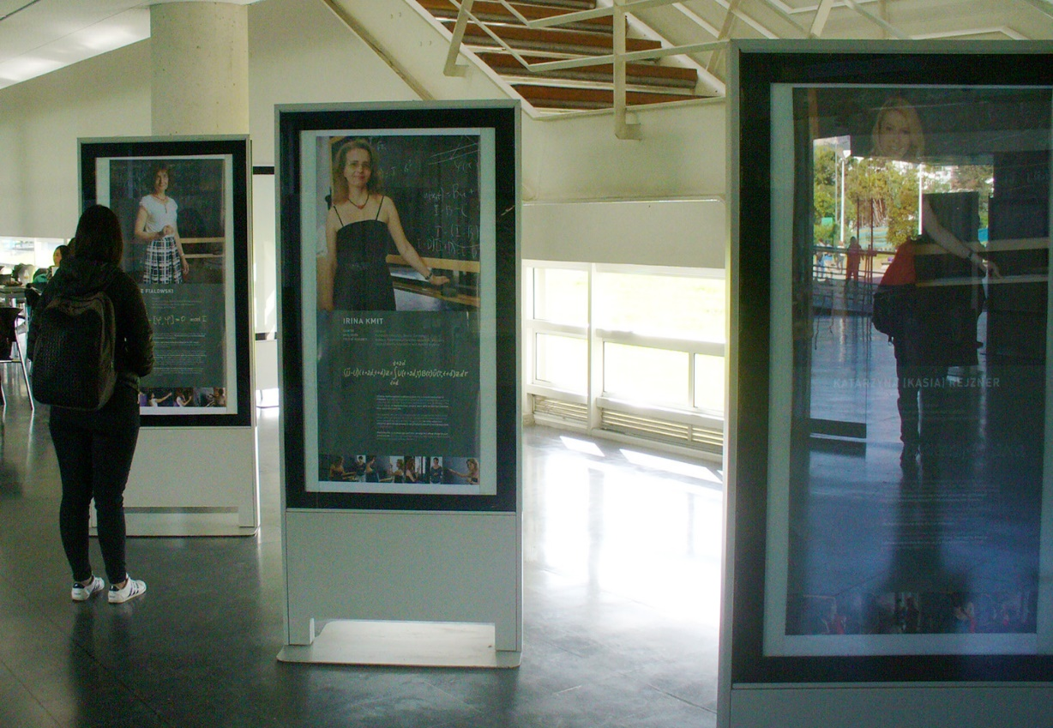
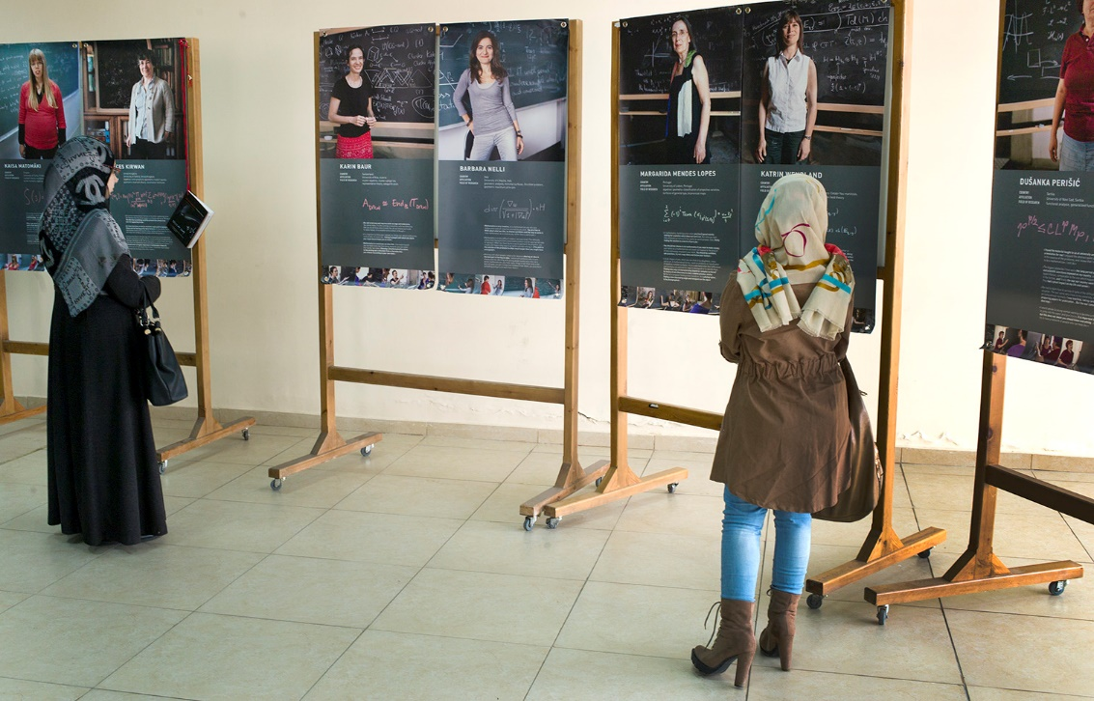
Barcelona, Universitat de Barcelona, March 2019
Bogotá, Universidad Nacional September 2017
Beirut Université Libanaise, Fanar February 2018

Slide 11
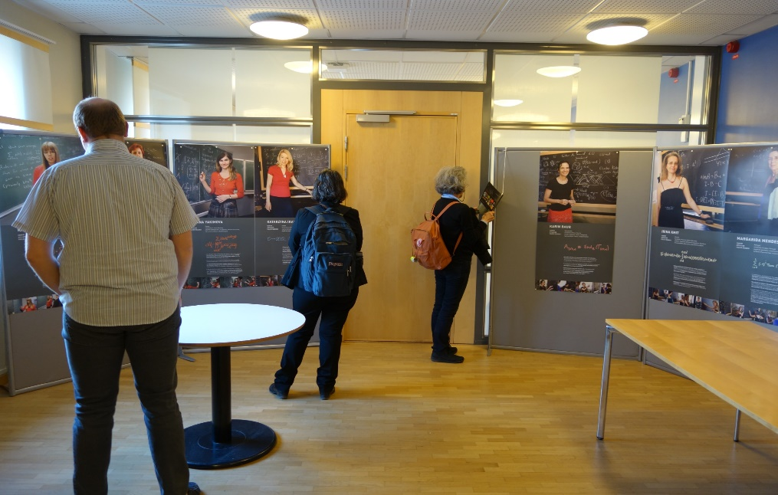
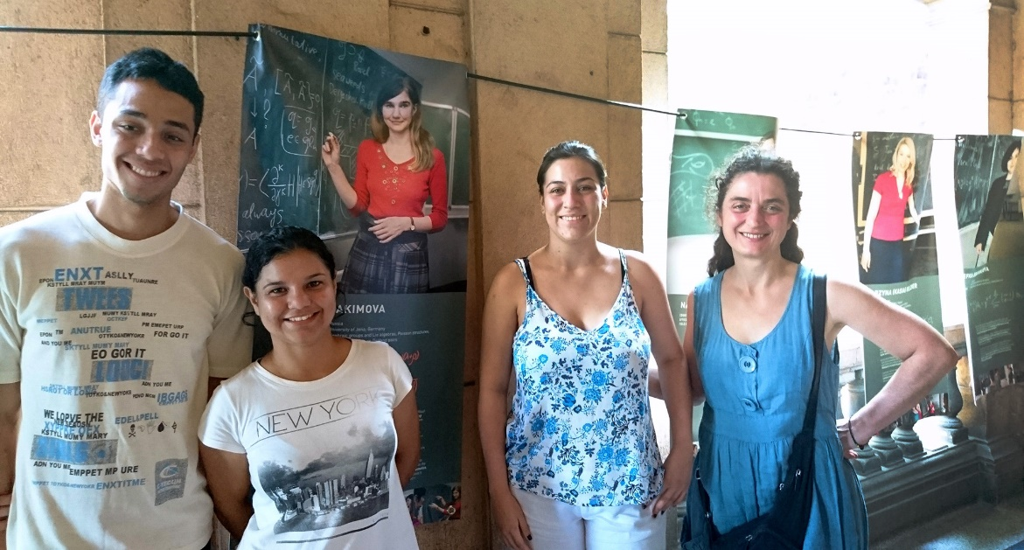
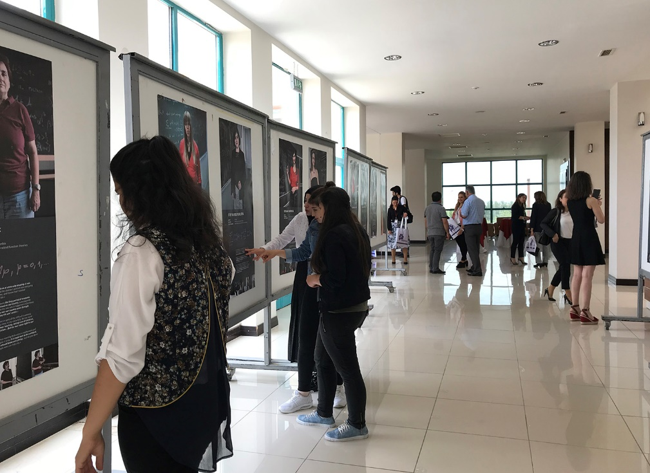
University of Gothenburg and Chalmers University of Technology Sweden April 2019
  Universidad de la Havana
  Cuba February 2017
  Diyarbakir, Dicle University Turkey May 2018

Slide 12
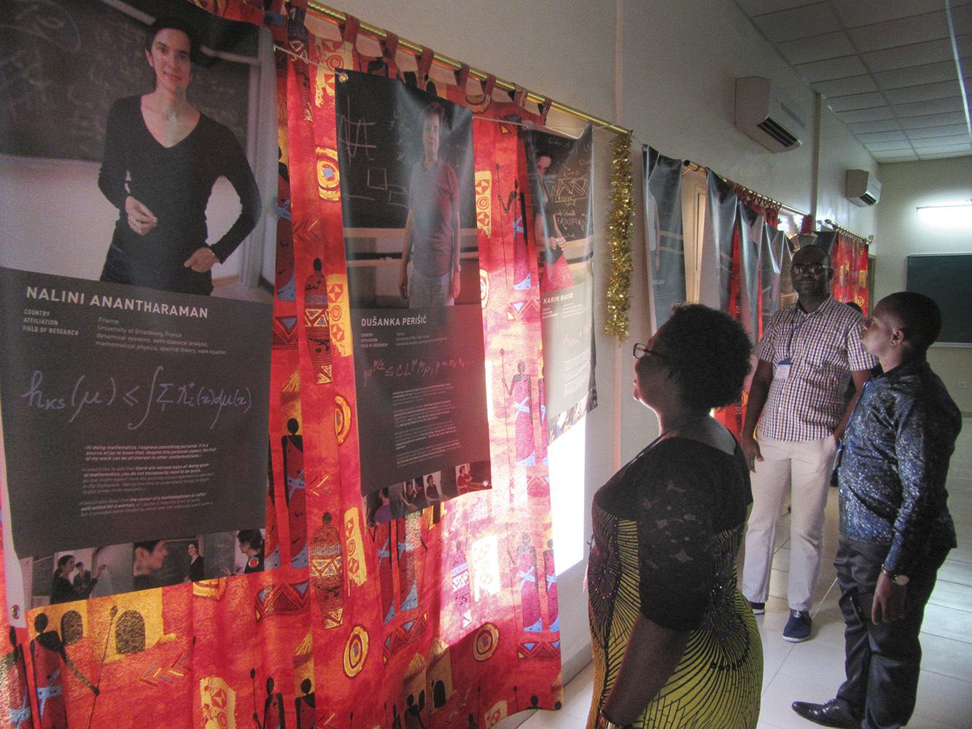
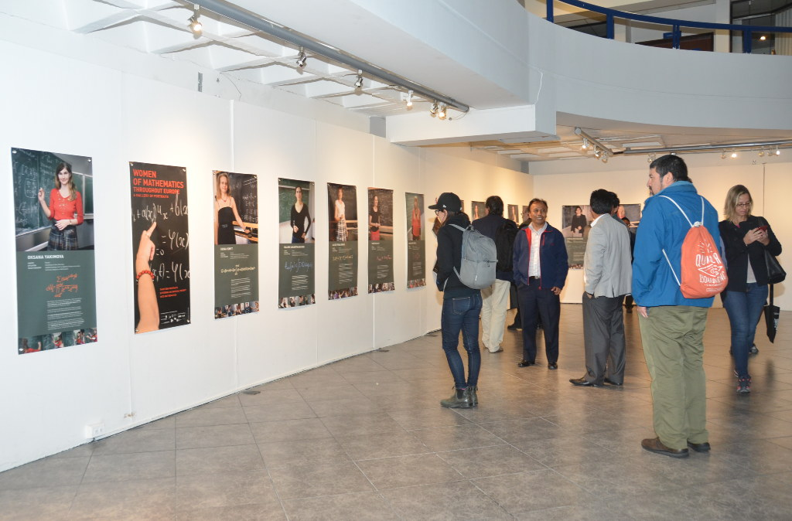
Quito, Pontificia Universidad Católica del Ecuador August 2017
AIMS, Senegal in M'bour
May 2018

Slide 13
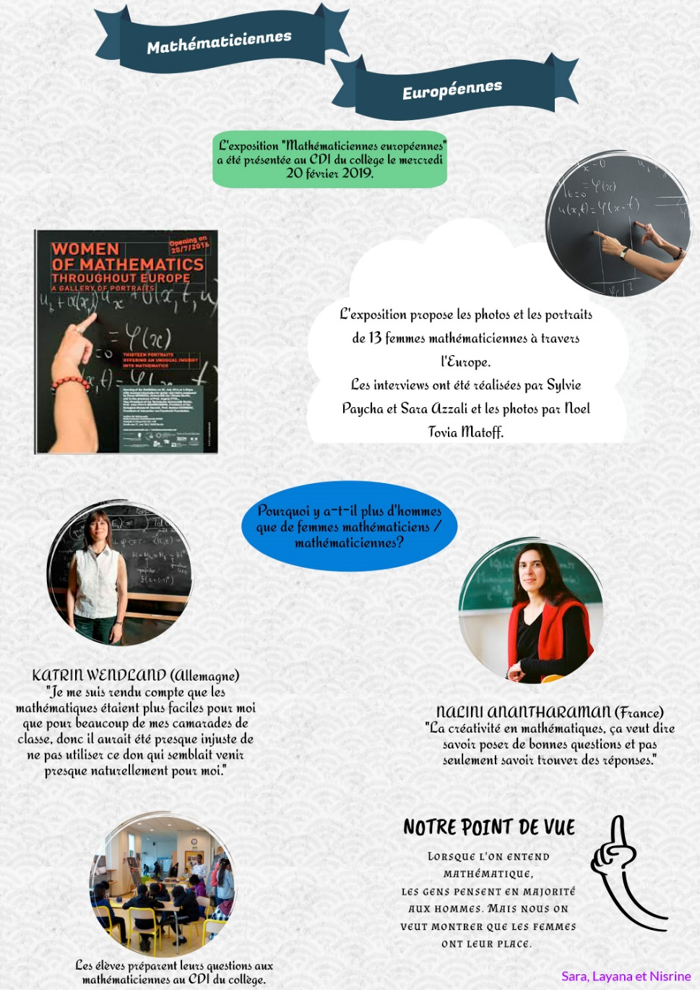
  SAINT DENIS (PARIS), FRANCE (II). October 2019
  SALZBURG, AUSTRIA. September 2017
  SANTIAGO, CHILE. March 2018
  SEVRAN, FRANCE. March 2017
  SOFIA, BULGARIA. February 2018
  SINGAPORE, REPUBLIC OF SINGAPORE. October 2018
  STRASBOURG, FRANCE.
  STUTTGART, GERMANY. November 2017
  SYDNEY, AUSTRALIA (I). May 2019
  SYDNEY, AUSTRALIA (II). August 2019
  TOKYO, JAPAN (I). March 2019
  TOKYO, JAPAN (II). October 2019
  TORINO, ITALY. April 2018
  TROMSØ, NORWAY. August 2019
  UTRECHT, THE NETHERLANDS. February 2017
  VALPARAISO, CHILE. January 2019
  VERONA, ITALY. May 2020
  VRATSA, BULGARIA. May 2017
  TÜBINGEN, GERMANY. November 2018
  TWENTE, THE NETHERLANDS. November 2017
  WARWICK, UK. October 2017
Saint Denis, Iqbal Masih school, October 2019

Slide 14
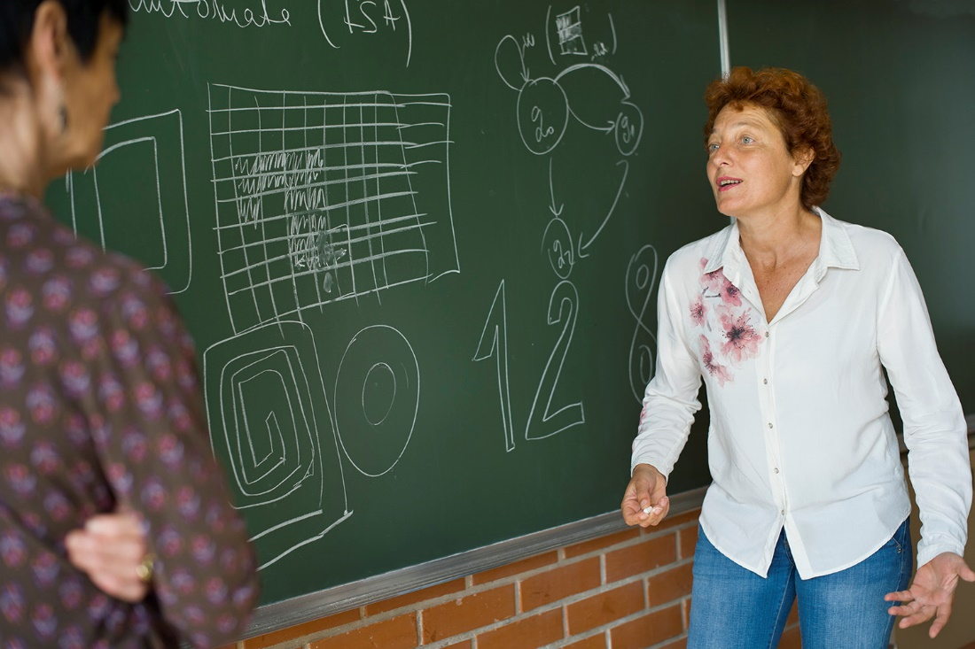
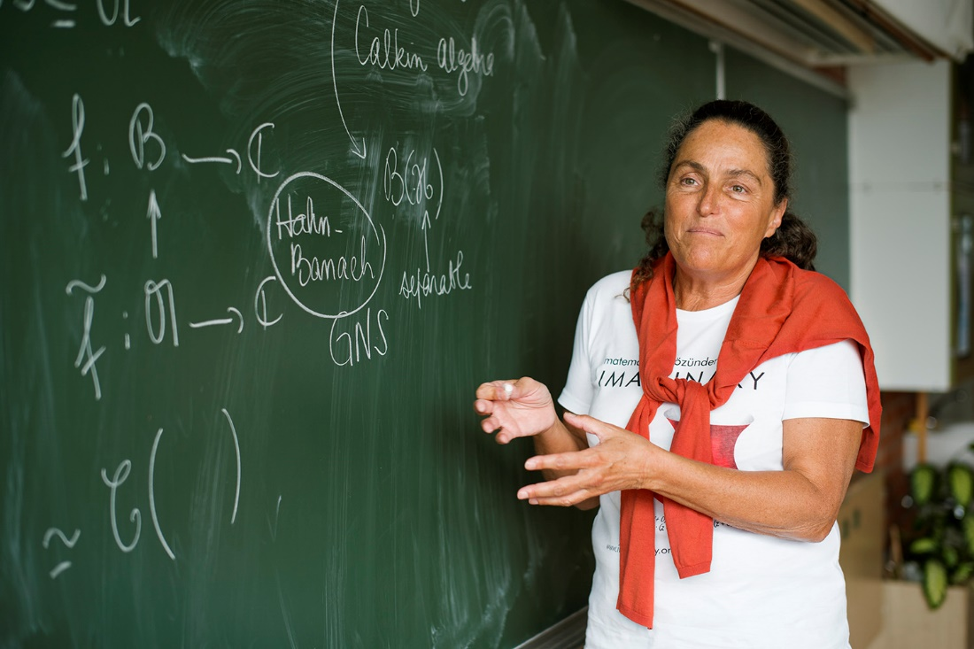
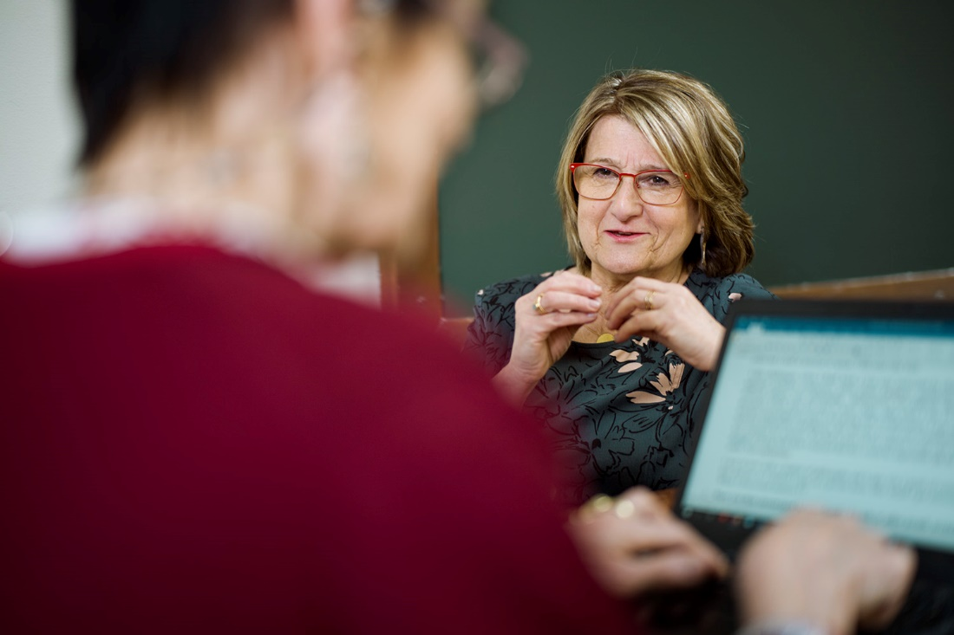
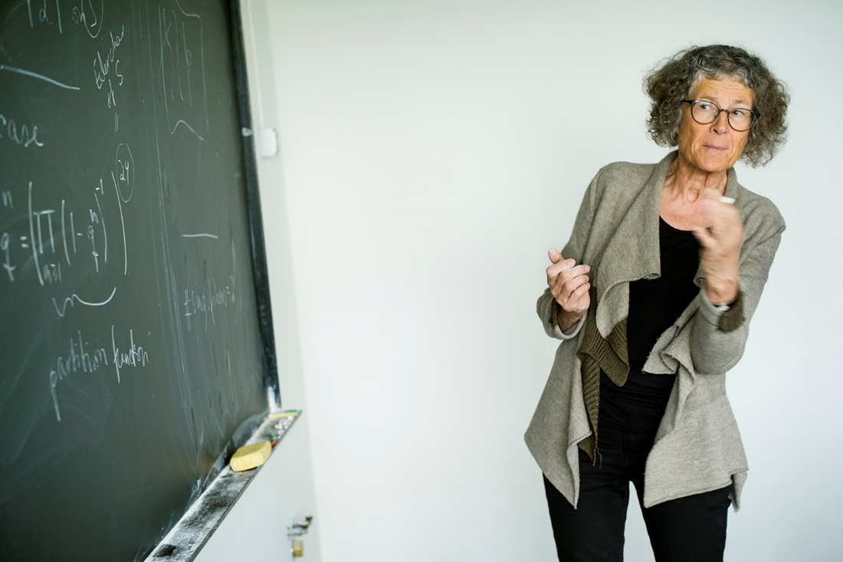
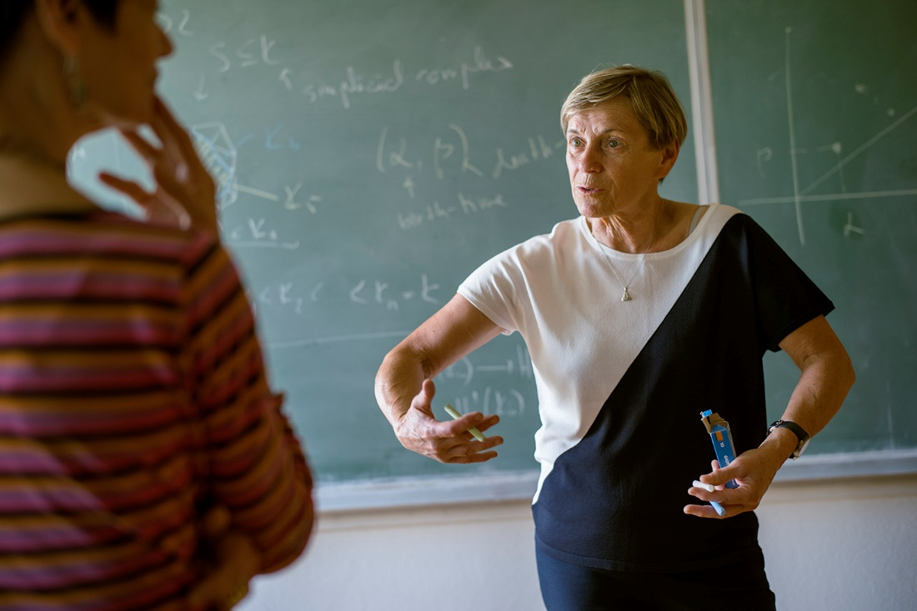
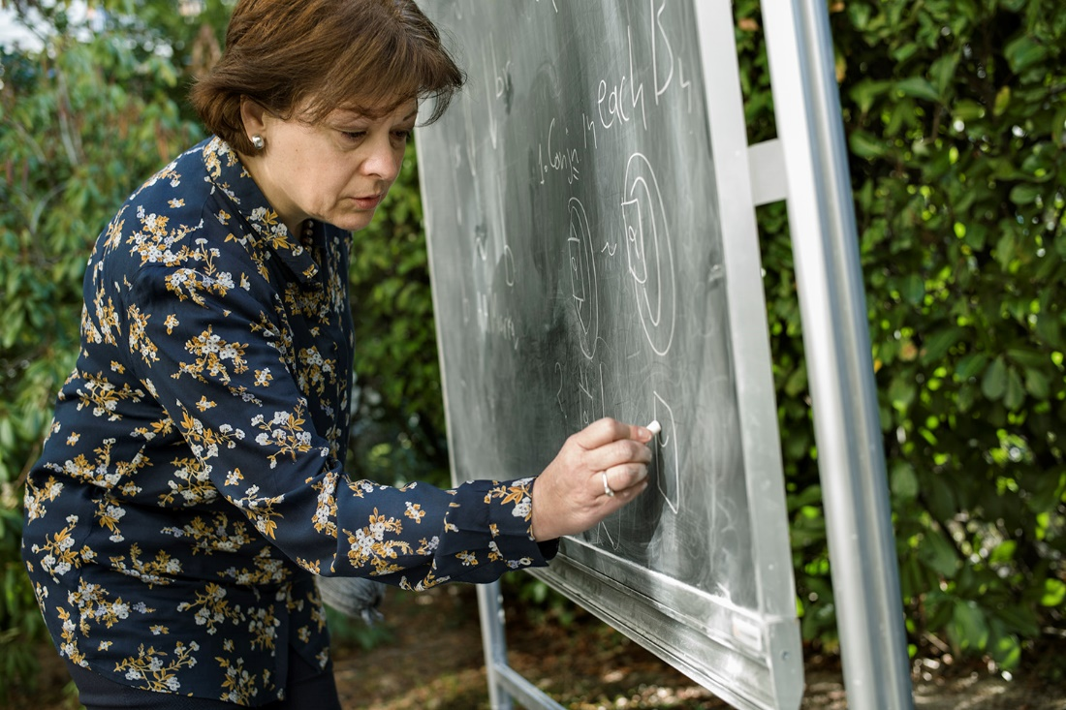
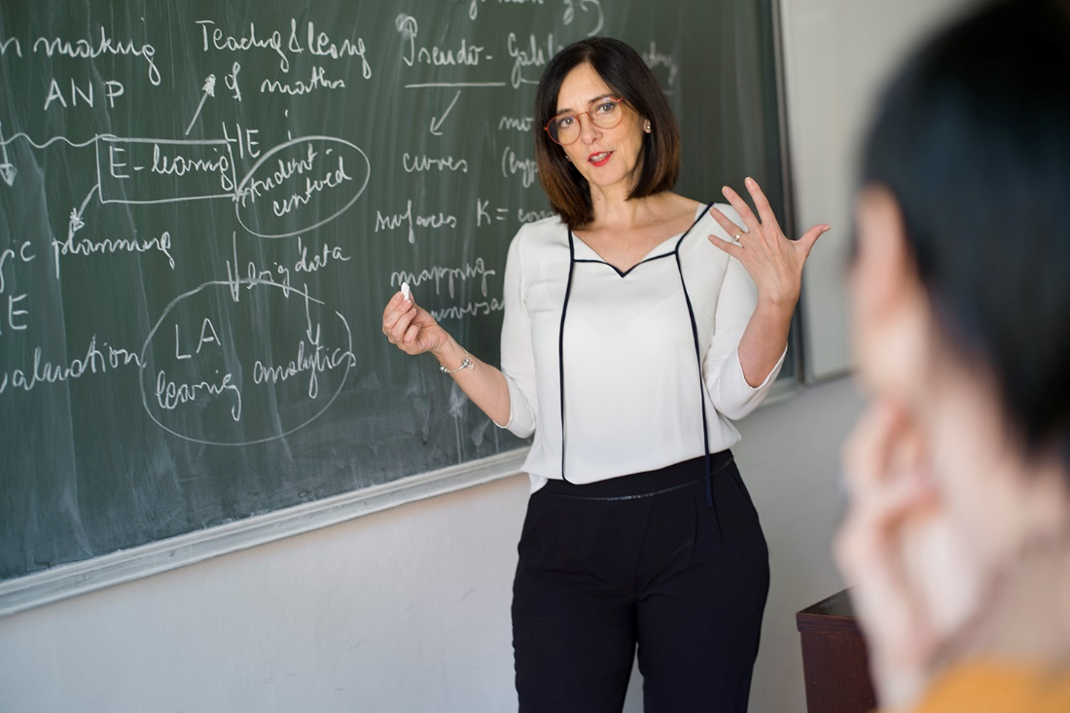
+ 7 mathematicians in 2019
Betül Tanbay
Biljana Stamatović
Marta Sanz-Solé
Ragni Piene
Neža Mramor Kosta
= 20 portraits
Sofia Lambropoulou
Blaženka Divjak

Slide 15
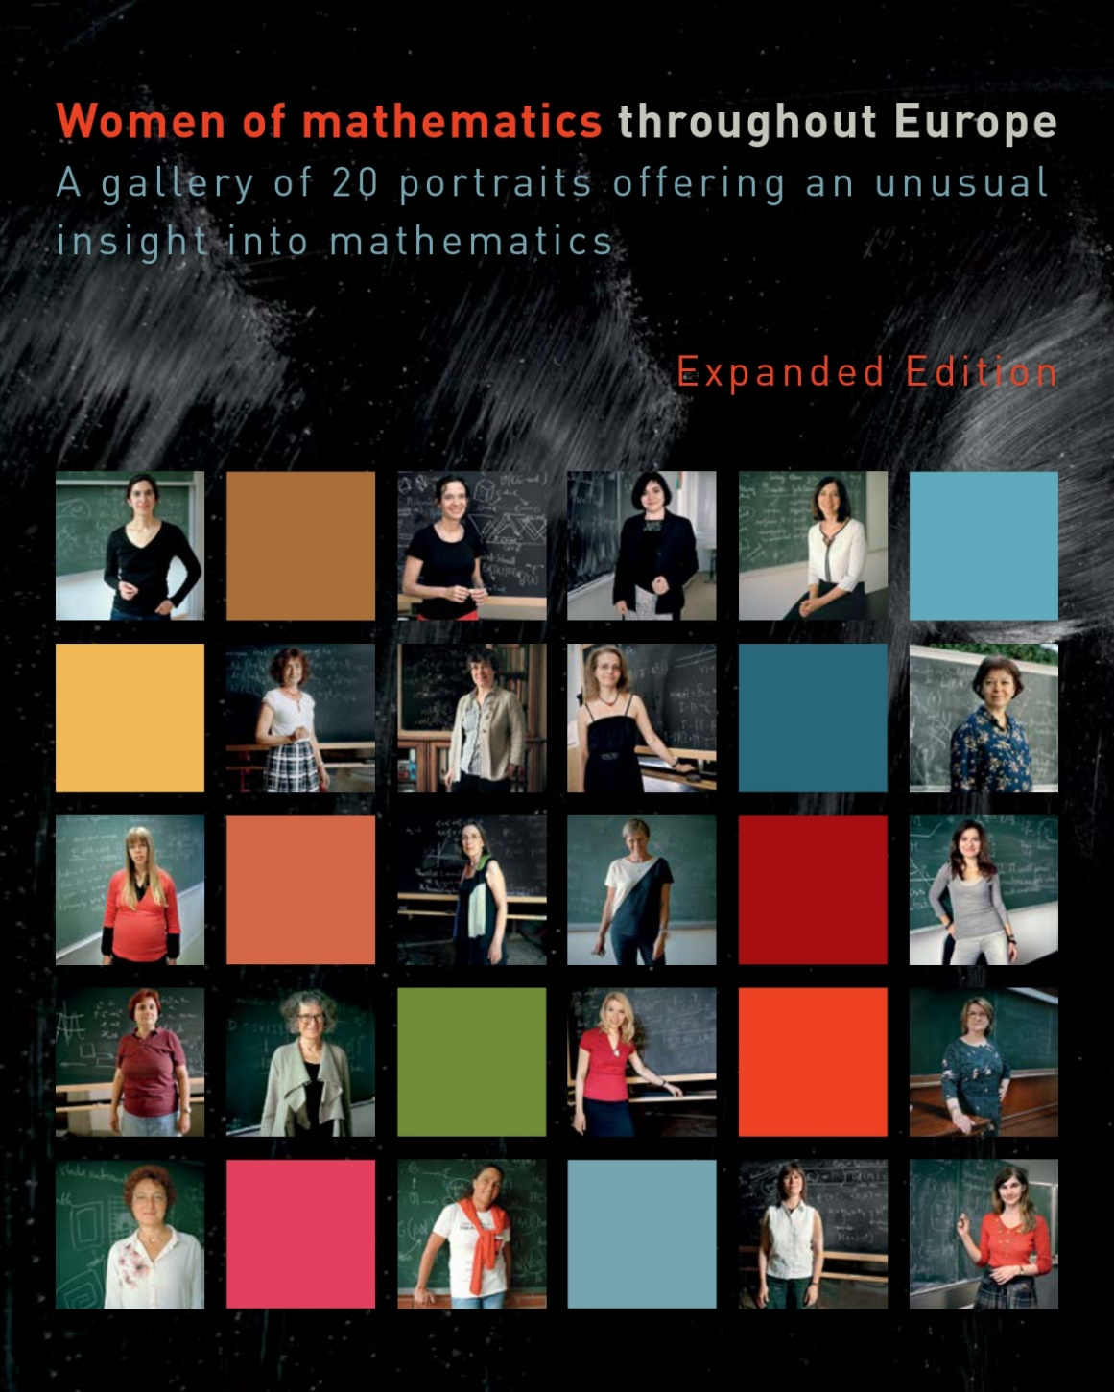
The expanded catalogue with the 20 portraits in 2021
13 mathematicians
Nalini Anantharaman (France)
Karin Baur (Switzerland, Austria)
Stefka Bouyuklieva (Bulgaria)
Alice Fialowski (Hungary)
Frances Kirwan (UK)
Irina Kmit (Ukraine/Germany)
Kaisa Matomäki (Finland)
Margarida Mendes Lopes (Portugal)
Barbara Nelli (Italy)
Dušanka Perišić (Serbia)
Katarzyna (Kasia) Rejzner (Poland/UK)
Katrin Wendland (Germany)
Oksana Yakimova (Russia/Germany)
+ 7 mathematicians
Blaženka Divjak (Croatia)
Sofia Lambropoulou (Greece)
Neža Mramor Kosta (Slovenia)
Ragni Piene (Norway)
Marta Sanz-Solé (Spain)
Biljana Stamatović (Montengro)
Betül Tanbay (Turkey)

Slide 16
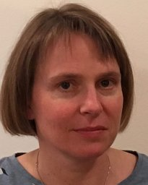
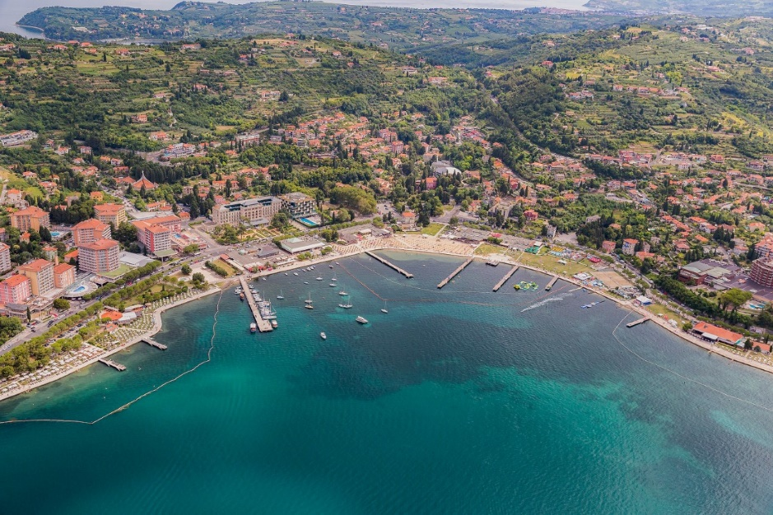
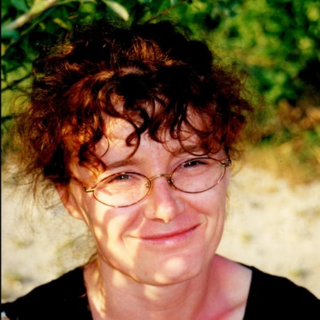
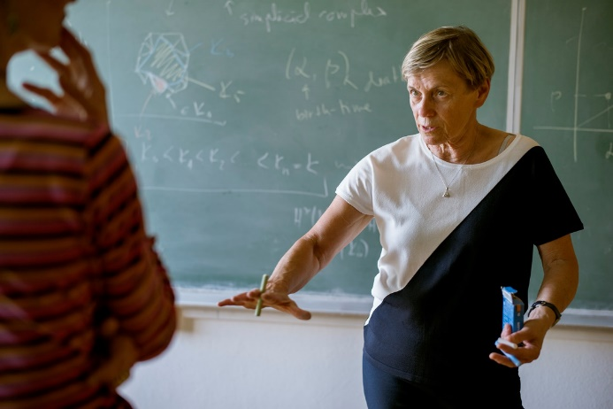
Five years later….. we were (virtually) at the 8th ECM in PortoroŽ, thanks to…
Marjeta KRAMAR
Jasna PREZELJ
8ECM & University of Primorska (our hosts)
The Society of Mathematicians, Physicists and Astronomers of Slovenia (DMFA) Faculty of Mathematics and Physics, University of Ljubljana
Institute for mathematics, Physics and Mechanics
Insurance companies SavaRe and Triglav
Neža MRAMOR-KOSTA

Slide 17
The latest venue in person:
Villa de Leyva, Colombia, July 31.-Aug.9th 2023

Slide 18
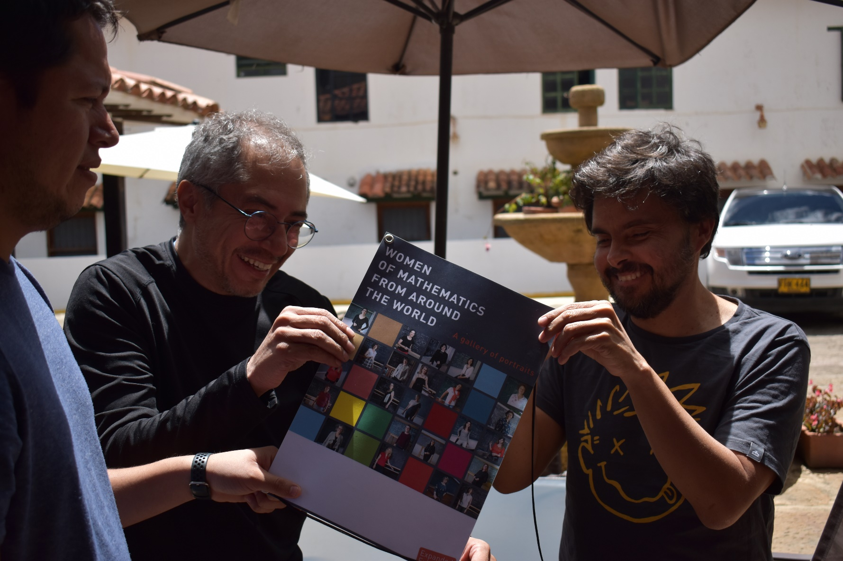
Villa de Leyva, Colombia, July 31st - August 9th 2023
Setting up the exhibition in the patio of the Hotel Santa Viviana….

Slide 19
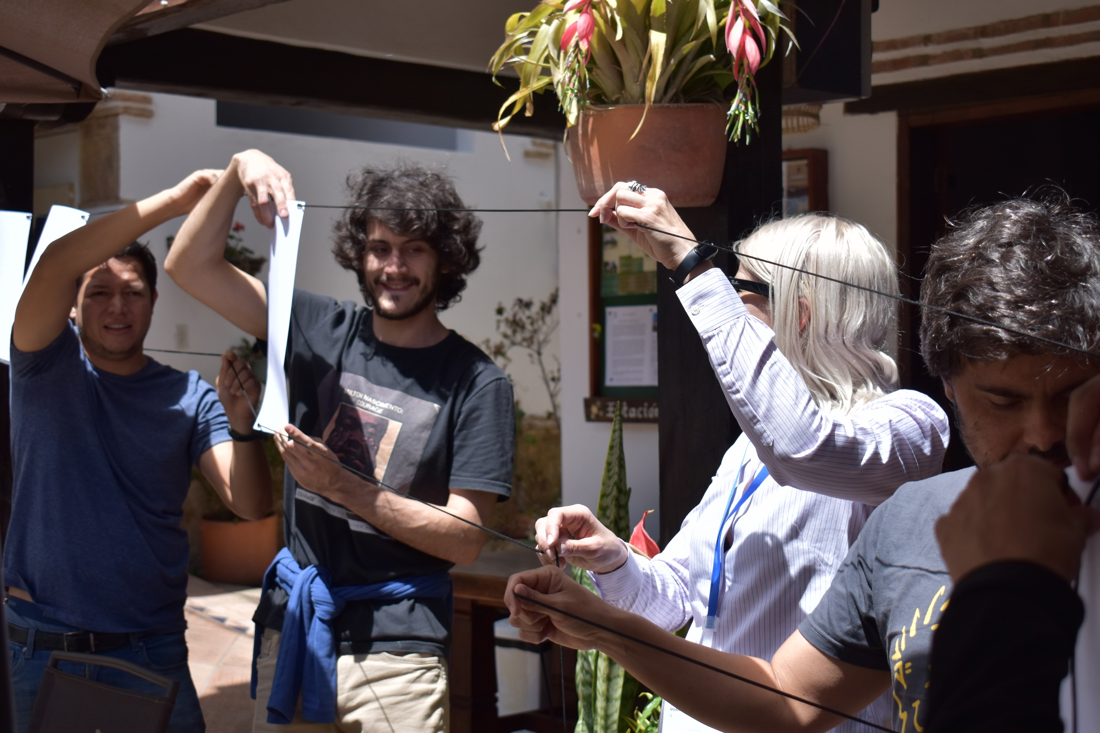

Slide 20
Sister exhibitions worldwide

Slide 21

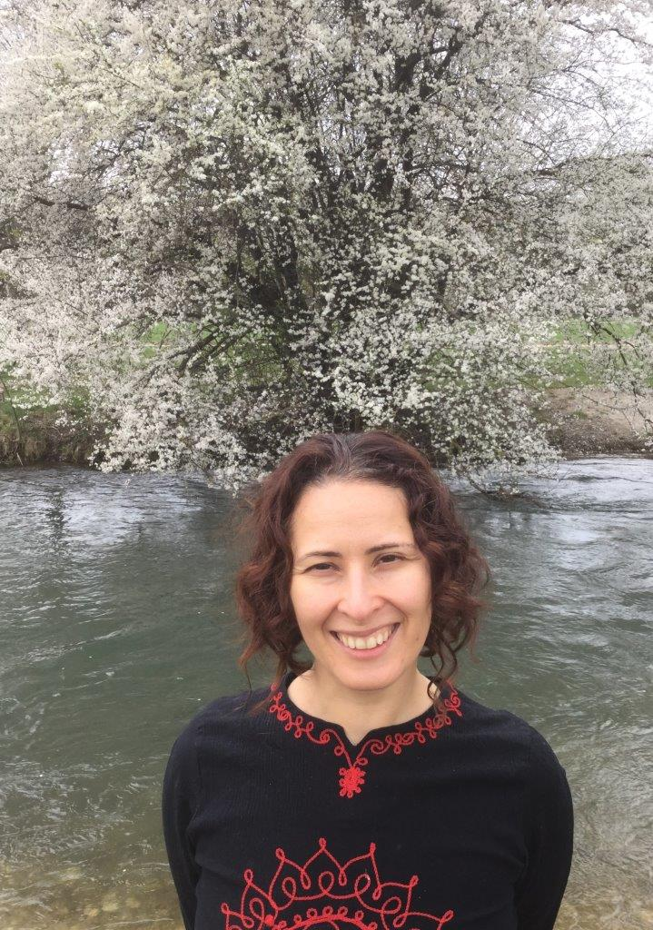
Mariel Saez, PUC Chile
South American women of mathematics
(2018-2020)
Carolina Bhering de Araujo (Brasil)
Carmen Cortázar Sanz (Chile)
Alicia Dickenstein (Argentina)
Lorna Figueroa Morales (Chile)
Yboon García Ramos (Peru)
Salomé Martínez Salazar (Chile)
Mónica Musso Polla (Italy/Chile)
Carolina Neira Jiménez (Colombia)
Amalia Pizarro Madariaga (Chile)
María Ofelia Ronco Vignau (Argentina)
María Soledad Torres Díaz (Chile)
11 portraits

Slide 22

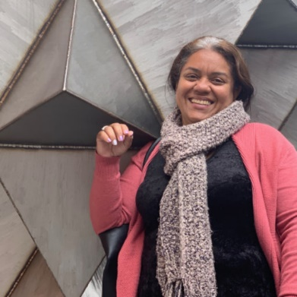
MUJERES MATEMÁTICAS EN COLOMBIA
UN TESTIMONIO GRÁFICO
Funded by: Pontificia Universidad Javeriana in Bogotá and el Grupo Santander.
Eddy Pariguan,
Pontificia Universidad Javeriana, Bogotá
23 portraits

Slide 23
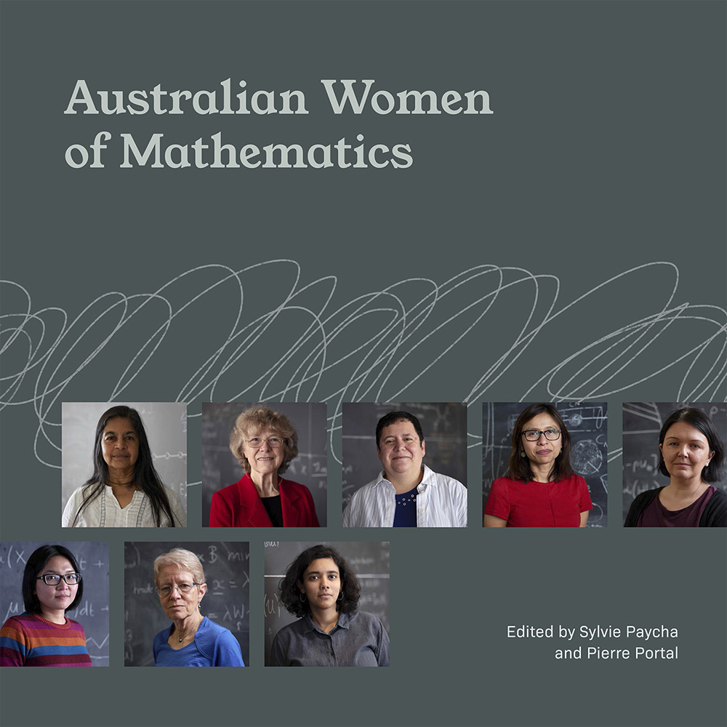
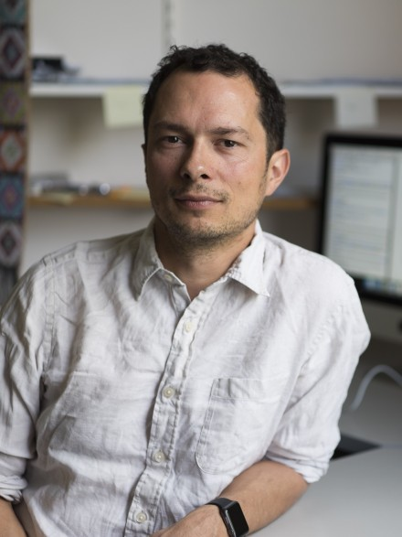
Australian women of mathematics (2019-2021)
Pierre Portal
ANU Canberra, Australia
Amie Albrecht
Anita Liebenau
Asilata Bapat
Cheryl Praeger
Giang Nguyen
Inge Koch
Jacqui Ramagge
Jennifer Flegg
Joan Licata
Kate Smith-Miles
Katharine Turner
Maria Athanassenas
Nalini Joshi
Natalie Thamwattana
Rowena Ball
Sophie Calabretto
16 portraits

Slide 24
FURTHER EXPANSIONS AROUND THE WORLD

Slide 25
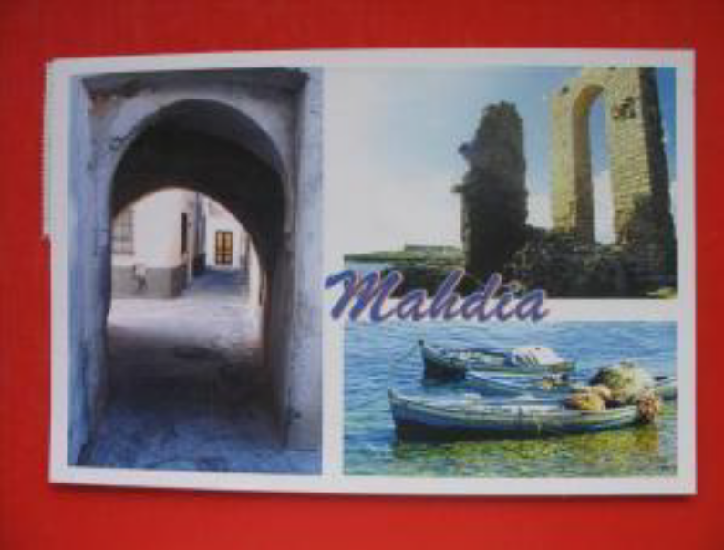
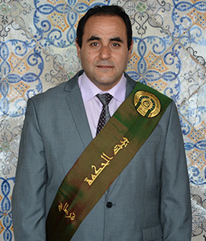
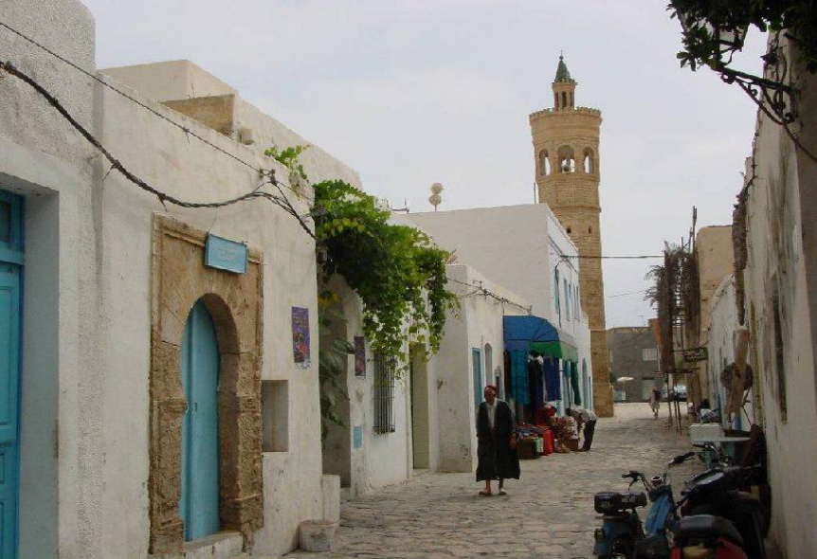
Tunisia, 14-17 March 2022
CSMT2022
25ème
Colloque Annuel
de la Société
Mathématique de Tunisie
Ali Baklouti

Slide 26

With portraits of Claire Voisin (France)
Sana Hizem and Saloua Alouadi (Tunisia)

Slide 27





OIST, OKINAWA, JAPAN March 20-24 2023
"Women at the intersection of mathematics and theoretical physics meet in Okinawa"
Reiko Tuomori
Yukari Ito
Reiko Toriumi
TOKYO
Okinawa Institute of Science and
Technology Graduate University

Slide 28

OIST, Okinawa, 20-24 March 2023

Slide 29


Extension in construction…..
with 34 portraits and
27 countries(incl. Congo, Costa Rica, India, Japan and Tunisia)

